Slide 1


Malware Analysis Tools and Techniques
Examining malicious web pages and documents -2
Last Update 29/12/2022

Slide 2
Lesson Objectives
Learn the tools and techniques for analysing Microsoft Office Files
Learn the tools and techniques for analysing PDF files

Slide 3
Malicious documents
Malicious documents (DOC, PPT, PDF, etc.) form a formidable threat
Carry code (Scripts, Shellcode)
Bypass many defenses that would block standalone executable files
Antivirus products not as mature in their handling of document files
Often used in targeted attacks

Slide 4
Analysis approach
Locate embedded code such as shellcode, VBA macros and JavaScript
Extract suspicious code
If relevant, disassemble /debug shellcode
If relevant, deofuscate and examine embedded non-shellcode code
Understand next steps in infection chain

Slide 5
Microsoft Office documents
Attractive to attackers
Regularly used by many people
Passed within the enterprise and across networks (e-mail, etc.)
Parsing binary Office document formats is not easy, so bug-prone
The files can include Visual Basic for Applications macro code (both legacy -.doc, .xls, .ppt and XML based Office formats -.docx, .xlsx, .pptx support VBA macros)

Slide 6
Two primary ways of executing code in Office documents
Embedded VBA macro code
- Usually executes on document open
- User may need to click OK
Embedded shellcode
- Executes by exploiting a vulnerability
- No user interaction required once the document is
opened

Slide 7
Microsoft Office format notes
Embedded VBA macro code Binary document files supported by Microsoft Office use the OLE2 (a.k.a. Structured Storage) format.
Stream Reservation Protocol (SRP) streams in OLE2 documents sometimes store a cached version of earlier macro code.
Office Open XML documents (.docx, .xlsm, etc.) supported by MS Office use zip compression to store contents. Macros embedded in OOXML files are stored inside the OLE2 binary file, which is within the zip archive.
RTF documents don’t support macros, but can contain other files embedded as OLE1 objects

Slide 8
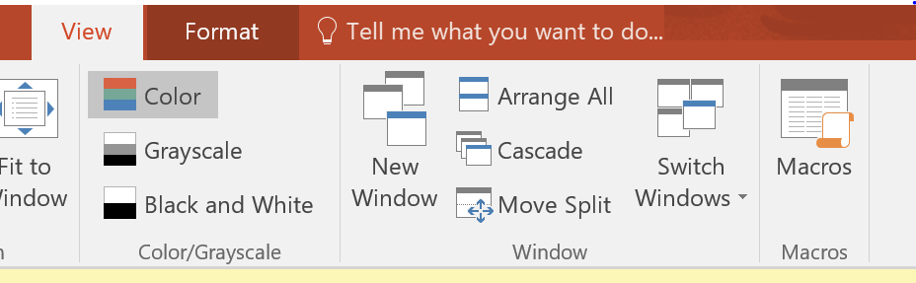
Viewing macro code using Microsoft Office
Click on the view tab
Select Macros > View Macros

Slide 9
Other tool : OfficeMalScanner
OfficeMalScanner is a MS Office forensic tool to scan for malicious traces, like shellcode heuristics,PE-files or embedded OLE streams. This tool developed by Frank Boldewin which is used for extracting VB macro code from malicious office documents(word,excel)

Slide 10
OfficeMalScanner : Usage
Usage: OfficeMalScanner <PPT, DOC or XLS file> <scan | info> <brute> <debug>
Options:
scan - scans for shellcode heuristics and encrypted PE-Files.
info - dumps OLE structures, offsets+length and saves found VB-Macro code.
inflate - decompresses Ms Office 2007 documents, e.g. docx, into a temp dir.
Switches: (only enabled if option "scan" was selected)
brute - enables the "brute force mode" to find encrypted stuff.
debug - prints out disassembly resp hexoutput if a heuristic was found.

Slide 11
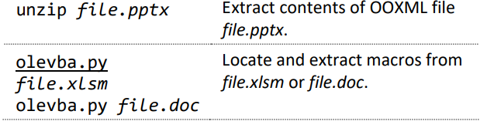
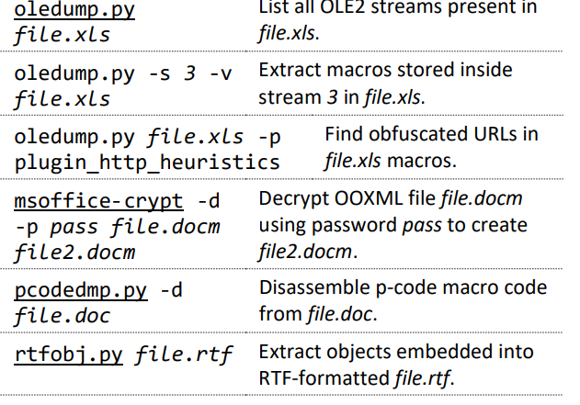
Useful MS Office File Analysis Commands

Slide 12
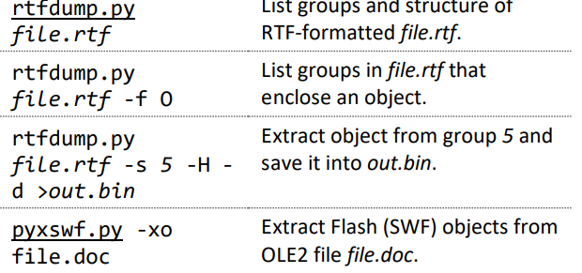
Useful MS Office File Analysis Commands

Slide 13
PDF Document files
Portable Document Format (PDF) is a widely-accepted document exchange format
Regularly used by many people, often deemed "secure"
Passed within the enterprise and across networks (e-mail, etc.)
Adobe Acrobat is feature-rich and complex, so it's bug-prone
PDF's can include active contents (embedded actions in JavaScript and ActionScript

Slide 14
The need to analyse PDF Document files
PDF documents have become very common in attacks
Relatively complex structure
- Allows a lot of options for obfuscations
- Even anti-virus vendors have trouble
Most vulnerable in parser components
JavaScript is used both as a source of vulnerabilities and for exploitation

Slide 15
Executing code via PDF Document files
Embedded shellcode executes by exploiting a vulnerability
Embedded JavaScript code helps with shellcode execution
Embedded Flash is also an option

Slide 16
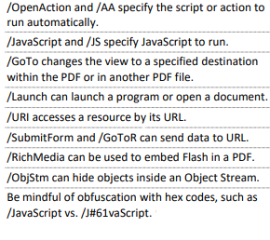
Risky PDF Format Tags

Slide 17

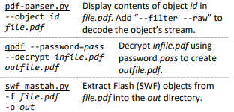
Useful PDF File Analysis Commands

Slide 18
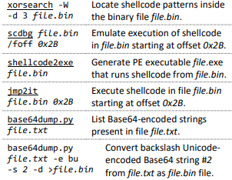
Shellcode and Other Analysis Commands

Slide 19
Tutorial
What is the difference between OLE1 and OLE2?
PDF file format: Basic structure https://resources.infosecinstitute.com/topic/pdf-file-format-basic-structure/
What are PDF tags? https://acrobatusers.com/tutorials/what-are-pdf-tags-and-why-should-i-care

